Slide 1
Educational Equity in Connecticut: A Data-Driven Look at School Performance
Course: DSC 205 – Data Visualization
Team Members: Marinela Deda, Aylin Mantilla, Chris Rodrigues
Date: May 13, 2025

Slide 2
Motivation
Connecticut ranks among the top in education, yet vast disparities exist between districts. This project explores whether funding and demographics influence school performance. Understanding these factors can help address inequality and improve public education outcomes.

Slide 3
Visualization Questions
1. Which districts have the highest and lowest SBAC test scores?
2. How does per-pupil spending vary by district?
3. Is there a correlation between spending and student performance?
4. How race and ethnicity relate to test performance in counties ?
5. What do student demographics look like in high- vs. low-performing districts?
6. Has school performance improved or declined over the past 3 years?
7. Are urban vs. suburban districts performing differently?

Slide 4
Data Sources
1. Smarter Balanced Assessment Test Results (SBAC):
https://public-edsight.ct.gov/performance/smarter-balanced-achievement-participation/growth-trajectory-tool?language=en_US
2. Per-Pupil Expenditures by District:
https://public-edsight.ct.gov/overview/per-pupil-expenditures-by-function---district/per-pupil-expenditures-by-funding-source---summary?language=en_US
3. District Demographics & Profiles:
https://public-edsight.ct.gov/overview/profile-and-performance-reports?language=en_US

Slide 5

🧹 Data Preparation
Cleaned column names and standardized formatting
Converted spending data to numeric values using pd.to_numeric()
Removed missing values to ensure clean visual output
Melted demographic columns to long format for race/ethnicity plots
Applied filters by year, county, district, and subject using sidebar inputs

Slide 6
Dashboard Layout (Sketch Description)
Sidebar Filters:
• Year
• County
• District
• Subject (ELA / Math)
Main Visualizations:
• Bar chart: Top and Bottom SBAC Scores by District
• Horizontal bar chart: Per-Pupil Spending by District
• Scatter plot: Spending vs. Performance (with trend line)
• Bubble chart: Demographics vs. Test Performance
• Bar chart: Scores by Majority Demographic Group
• Pie chart: Demographics in High- vs. Low-Scoring Districts
• Line chart: Performance Over Time (State vs. County)
• Bar chart: Urban vs. Suburban Comparison

Slide 7
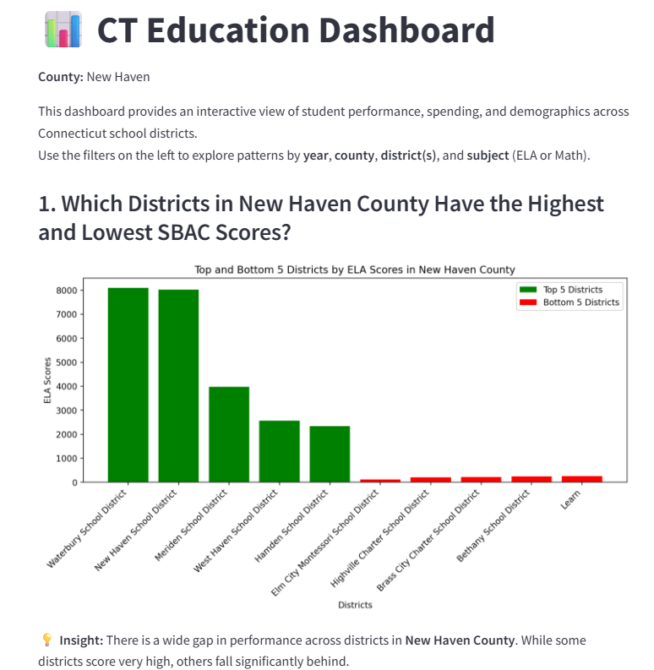
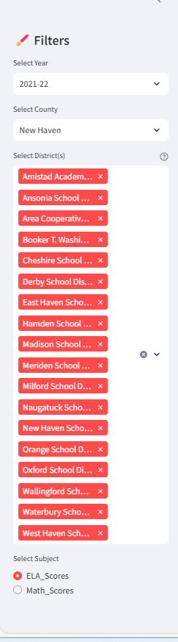
Notes:
📊 Slide 1 Interpretation: District Performance Extremes in New Haven County
This slide highlights the five districts in New Haven County with the highest and lowest SBAC scores. The green bars represent top-performing districts, while red bars show the lowest performers.
Key Observations:
Top Performers: Districts like Waterbury and New Haven show exceptionally high scores, with ELA scores exceeding 8,000.
Lowest Performers: Several charter schools (e.g., Elm City Montessori, Highville Charter, Brass City Charter) report significantly lower scores.
Performance Gap: The disparity between the highest and lowest scoring districts is stark, visually reinforcing the theme of educational inequality in Connecticut.
Contextual Link to Project Purpose: These differences raise critical questions about how district-level resources and demographics contribute to performance. This slide sets the foundation for further analysis on whether funding, racial composition, or urban/suburban context are driving these gaps.

Slide 8
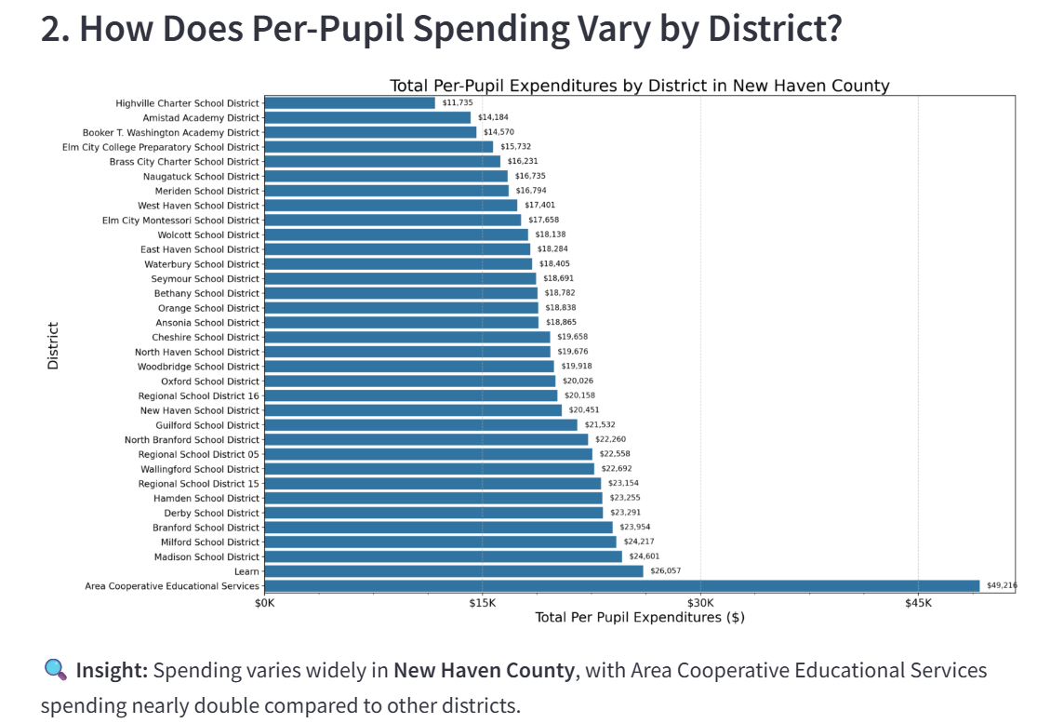
Notes:
This bar chart compares total per-pupil spending across districts in New Haven County.
We can immediately see a large gap — with Area Cooperative Educational Services spending over $49,000 per student, while districts like Highville Charter School spend less than $12,000.
This variation suggests that students in different districts may not have equal access to funding, which could impact the quality of education, resources, and support services.
As we move forward, we’ll explore whether this spending difference actually translates into better student performance.

Slide 9
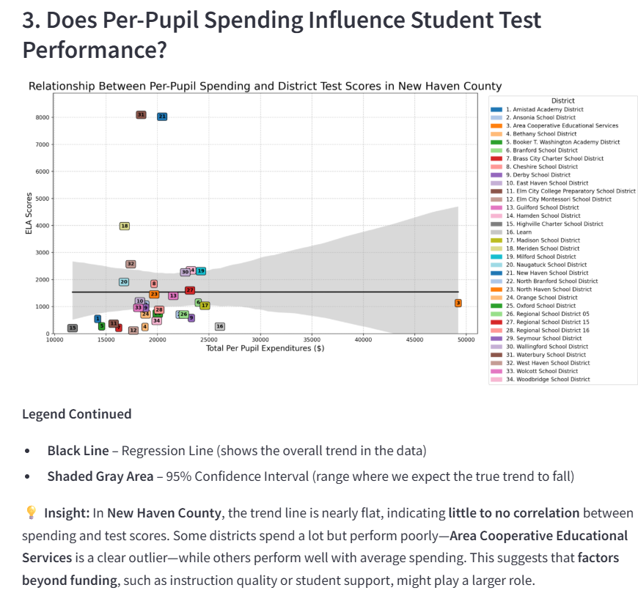
Notes:
This chart explores the relationship between per-pupil spending and ELA scores for school districts in New Haven County.
Each labeled square represents a district, with the numbers corresponding to the legend. The black regression line shows the overall trend, and we can see it's relatively flat—this suggests that higher spending doesn't always correlate with higher test performance.
A clear outlier is District 3 — Area Cooperative Educational Services, which spends close to $50,000 per student yet scores very low in ELA. This suggests that spending alone isn’t a reliable predictor of academic success, and other variables—like instructional quality, socio-economic context, or student needs—may play a large role.
The shaded gray area is the confidence interval, giving us a sense of how strong or weak the relationship is. In this case, the wide band indicates a weak or highly variable correlation, meaning that even with similar spending, districts can have very different outcomes.

Slide 10
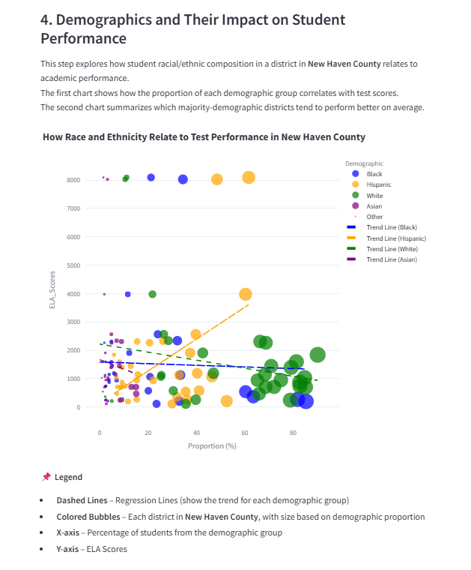
Notes:
This chart analyzes the relationship between student demographics and test performance in New Haven County.
Each bubble represents a district, with its size indicating the proportion of students from a specific demographic.
The X-axis shows the percentage of a racial/ethnic group in a district.
The Y-axis shows the corresponding ELA scores.
The dashed lines show the trend for each group:
Hispanic (orange line): The line goes up, which means that districts with more Hispanic students tend to have higher ELA scores. That’s a positive correlation.
Black, White, and Asian (blue, green, and purple lines): Their lines are flat or slightly down, meaning no clear relationship — or sometimes even a slight decrease in scores as the percentage increases.
Race or ethnicity alone does not fully explain performance, but it might play a role, especially when connected with other factors like school funding, teacher quality, access to resources and community support.
This chart helps us see trends, not causes.

Slide 11
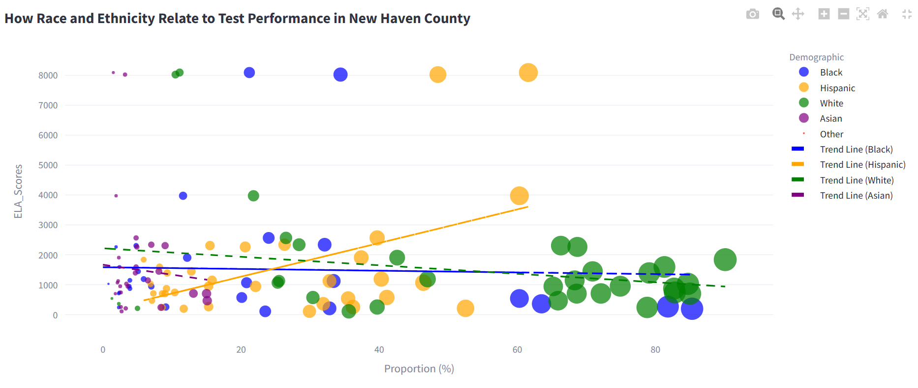

Slide 12
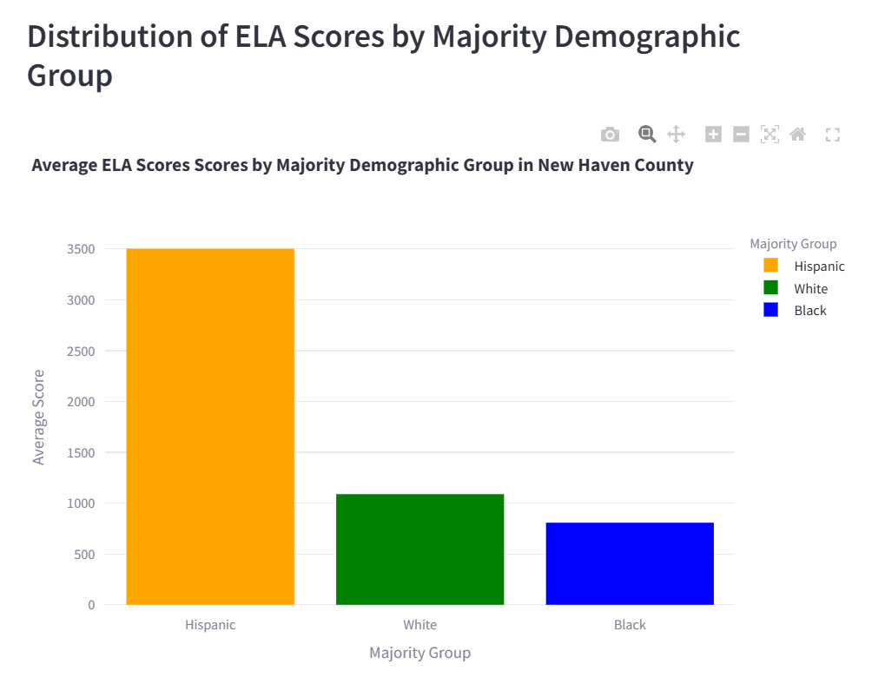
Notes:
This chart shows the average ELA scores for districts in New Haven County, grouped by the majority racial/ethnic group in each district.
🔍 Key Insights:
Hispanic-majority districts have the highest average ELA scores.
White- and Black-majority districts score significantly lower, with Black-majority districts showing the lowest averages.
📌 What This Suggests:
These differences don’t reflect student ability, but may highlight underlying inequalities across districts.
Factors like:
School funding
Teacher quality
Community resources
Access to support programs likely play a major role.
🧠 Takeaway: A district’s majority demographic group can correlate with performance, but the real drivers are systemic conditions that affect educational equity.

Slide 13
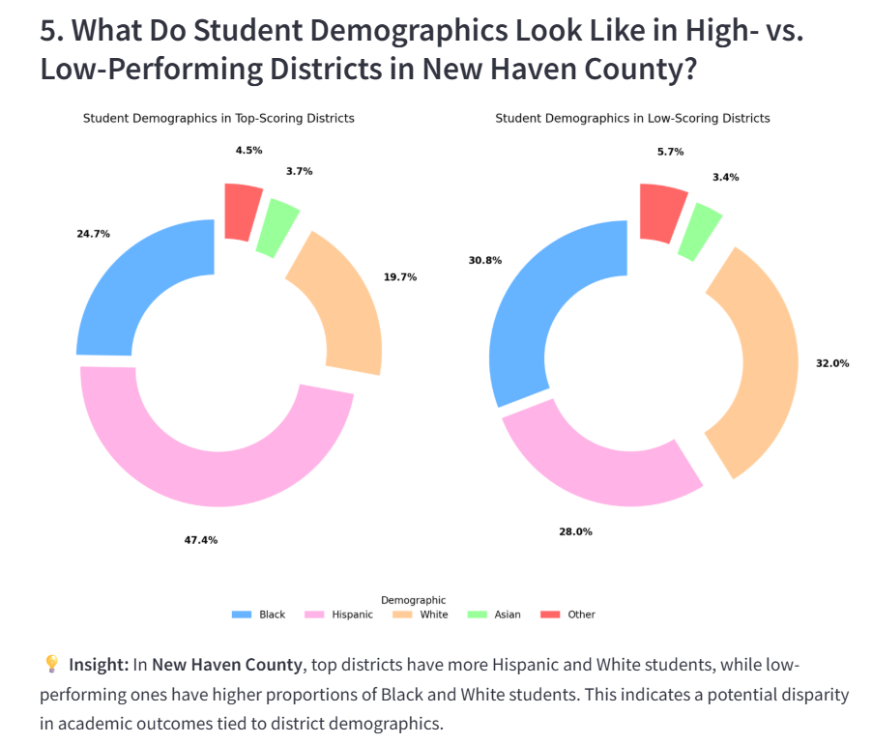
Notes:
This slide compares student demographics in top-scoring vs. low-scoring districts in New Haven County.
Top-Scoring Districts have:
Higher percentage of Hispanic students (47.4%)
Lower percentage of White students (19.7%)
Low-Scoring Districts have:
Higher percentage of White students (32.0%)
Lower percentage of Hispanic students (28.0%)
Black student proportions are also higher in low-performing districts (30.8%) than in top-performing ones (24.7%).
📌 What This Suggests:
Demographic makeup differs meaningfully between high- and low-performing districts.
However, demographics alone don't determine success—they often reflect:
Historical inequities
Socioeconomic status
Access to experienced teachers
School funding and community resources
🧠 Takeaway: To close performance gaps, we must look beyond test scores and address deeper structural challenges in education.

Slide 14
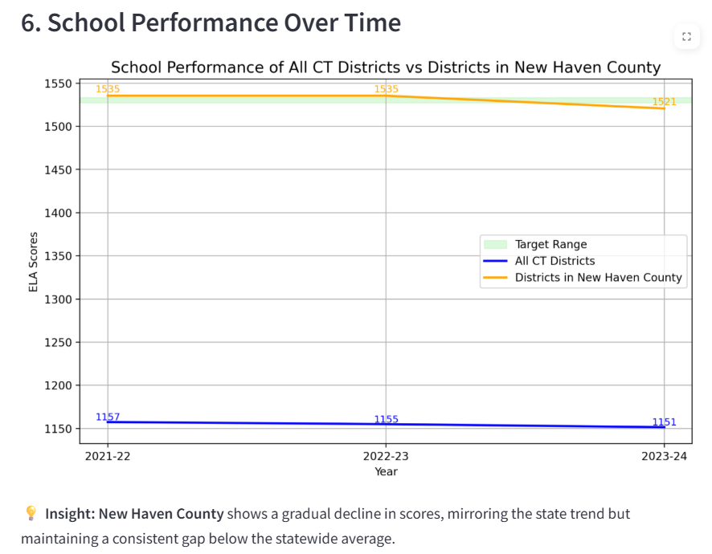
Notes:
This chart compares ELA test score trends over 3 years.
The blue line represents all Connecticut districts, the orange line shows New Haven County, and the green shaded area is the state target range.
New Haven County consistently performs above the state average, but both groups show a slight decline in scores.
New Haven dropped from 1535 to 1521; the state from 1157 to 1151.
Neither meets the target, but New Haven is closer.
This suggests that while the county is doing relatively well, there's room for improvement.
Factors like curriculum, teacher support, and resource allocation might influence these trends.

Slide 15
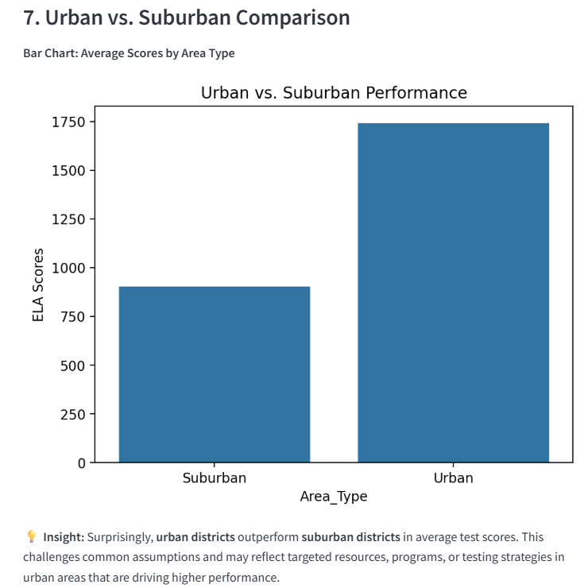
Notes:
This bar chart compares average ELA test scores between urban and suburban areas.
Interestingly, urban districts show significantly higher scores than suburban ones in this dataset.
This challenges common assumptions that suburban schools always outperform urban ones.
Possible explanations could include:
Focused interventions or programs in urban schools.
Differences in how “urban” and “suburban” are classified in the dataset.
Data quality or small sample size in certain areas.
It’s important to investigate deeper rather than assume one group always performs better.

Slide 16
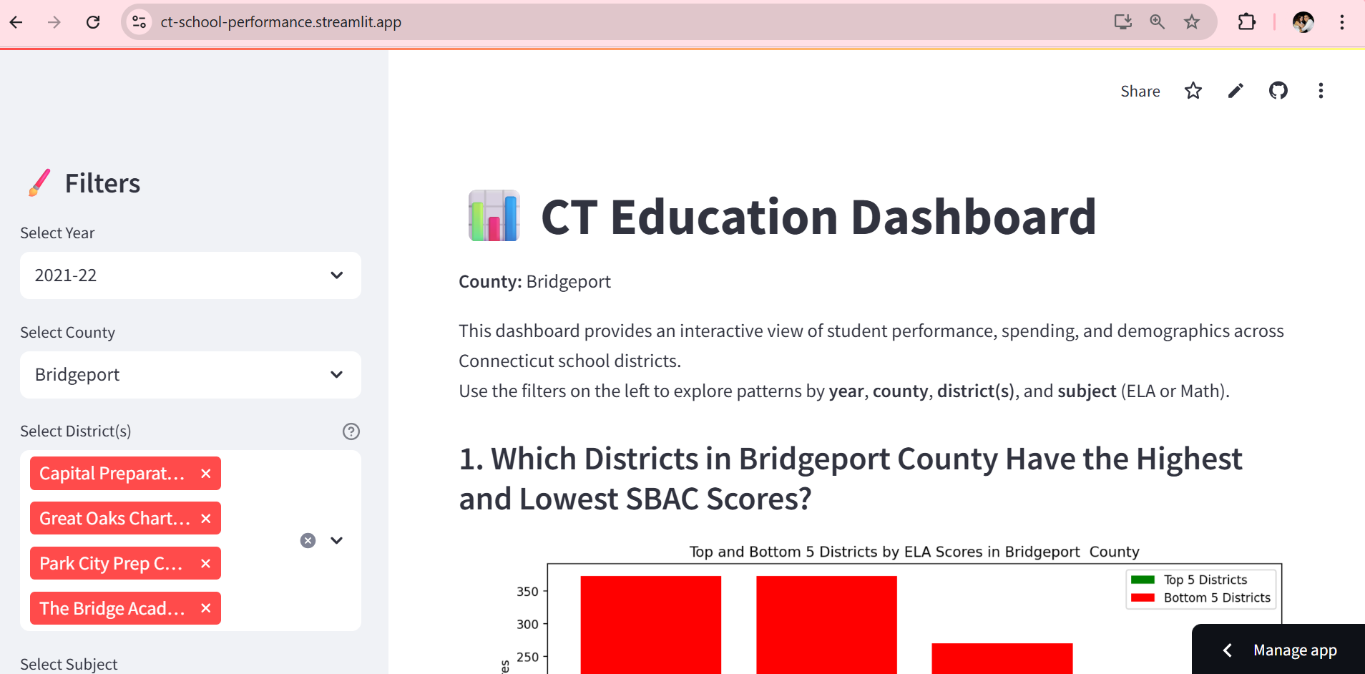
The Dashboard Is Now Live!
You can now explore our interactive Streamlit dashboard right in your browser.
👉 Click here to view the live dashboard
https://ct-school-performance.streamlit.app

Slide 17
Discuss Technical Aspects of Your Streamlit Application
Feature | How to Explain the Code
Sidebar Filters st.sidebar.selectbox(...), st.sidebar.radio(...) | “This code adds filters to the sidebar, allowing the user to choose things like the year, county, or subject. It makes the dashboard interactive.”
Dynamic Filtering county_df = df[(df["Year"] == year) & (df["County"] == selected_county)] | “This line filters the dataset based on what the user selects in the sidebar, so we only analyze the data we’re interested in.”
Step 1 (Bar Chart) ax.bar(...) and st.pyplot(fig) | “Here we use Matplotlib to create a bar chart and show it in Streamlit with st.pyplot(). It shows the highest and lowest performing districts.”
Step 3 (Scatter Plot) sns.regplot(..., ci=95) | “We use Seaborn to create a scatter plot with a regression line and a 95% confidence interval to see if there’s a pattern between spending and test scores.”
Step 4 (Bubble Chart) fig1 = px.scatter(...) + go.Scatter(...) | “We use Plotly to create an interactive bubble chart, and we add trend lines for each demographic group using go.Scatter().”
Step 6 (Line Chart) ax.plot(...), ax.axhspan(...) | “This line chart tracks test performance over time. axhspan() adds a green shaded area to show the target score range.”
Step 7 (Urban vs. Suburban) sns.barplot(data=area_df, ...) | “This uses Seaborn to compare average scores in urban and suburban districts. The chart helps show if location affects performance.”

Slide 18
Discussion & Takeaways
From the visualizations, we observed meaningful differences in student performance across Connecticut districts.
Some important takeaways include:
Per-pupil spending does not always lead to higher test scores. While there is a general upward trend, some districts with very high or very low spending fall outside of it, suggesting that money alone isn't the only factor.
Demographics don’t directly cause performance outcomes, but they can reflect deeper issues. For example, districts with higher percentages of Hispanic students tended to score higher in ELA. This may point to strong support systems or resources in those districts, not to race or ethnicity itself.
In top-performing districts, Hispanic students made up the largest demographic group. In lower-performing districts, the majority populations were Black and White. This doesn't mean one group is better than another — rather, it shows how external factors connected to demographics (like funding, community support, or socioeconomic status) may affect performance.
Urban vs. Suburban: Urban districts performed better than suburban ones in ELA scores. This challenges common assumptions and shows that success depends more on the support and investment a district receives, not just its location.

Slide 19
Suggestions for Further Work
Although our dashboard includes data from all Connecticut counties, we focused on New Haven County to allow for a more detailed and manageable analysis within our limited time.
In the future, this project could be expanded in the following ways:
Include other counties across Connecticut to see if the patterns we observed in New Haven County are consistent across the state.
Break down performance by grade level or subject (ELA vs. Math) to explore whether certain grades or subjects show stronger or weaker results. While this level of detail wasn’t available in the official dataset—only subject-level scores at the district level—it's an important area worth exploring in future research.
Analyze teacher-related factors, such as student-to-teacher ratios, years of experience, and instructional resources. Although we couldn’t access this information in our current dataset, these factors are likely to play a key role in student outcomes and would be valuable to investigate further.
Track performance over a longer period of time to examine how trends change and whether new policies or investments lead to real improvements.

Slide 20
Conclusion
This project gave us insight into how funding and demographics relate to school performance in New Haven County.
While these factors matter, they don’t fully explain outcomes—highlighting the need to consider broader issues like equity and support.

Slide 21
Timeline & Team Roles
Marinela Deda: Data Cleaning, Integration, Coding & Dashboard Coordination. Also responsible for GitHub repository setup, Streamlit Cloud hosting, and successful app deployment.
Chris Rodrigues : Visualization Design & Layout
Aylin Mantilla : Presentation Writing, Recording, and Editing
Timeline:
May 13: Final Presentation (10:15am-12:15pm)

Slide 22

Thank You!
Questions?

